Slide 1
Tele-Behavioral Health: Improving Health Care Access for Health Center Populations
October 17, 2024

Slide 2
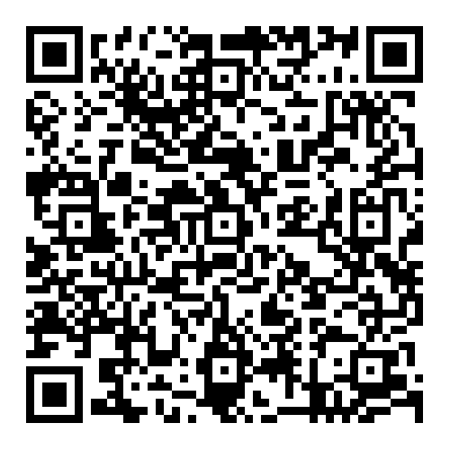
Session Two: Telebehavioral Health Program Optimization and Provider Perspective
October 17th, 2024- 3pm EST

Slide 3
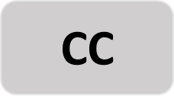
Zoom Orientation
1
Captions
To adjust or remove captions, click the “Live Transcript” button at the bottom of your Zoom window and select “Hide Subtitle” or “Show Subtitle.”
Live Transcript
2
Questions
Please add your questions for the speaker and comments for the group into the Chat box.
3
Technical Issues
Please message us in the chat.
Chat
4
Recording
This session will be recorded and made available to participants.
Recording

Slide 4
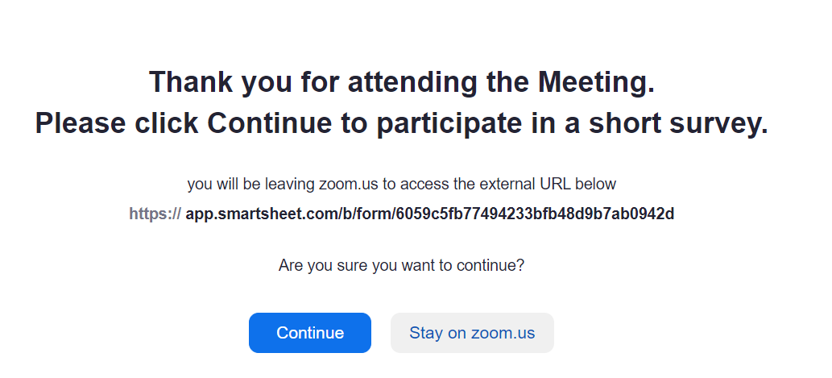
Accreditation Statement
Accreditation Statement: The National Nurse-Led Care Consortium is accredited as a provider of nursing continuing professional development by the American Nurses Credentialing Center’s Commission on Accreditation. Each session has been approved for 1.0 NCPD contact hours.
Success Completion Requirements: To obtain 1.0 contact hours of nursing continuing professional development, you must participate in the entire activity, complete the evaluation, and achieve an 80% pass rate on the knowledge gain assessment following the session.
Notes:
At end of zoom you will have a link will pop up that leads to the evaluation, once the evaluation is complete, you will have access to the knowledge quiz

Slide 5
What is an NTTAP’s role to support
Health Center Excellence
Provide population-specific T/TA on HRSA-defined objectives
Support health center capacity to provide interdisciplinary, culturally competent care
Consultation and support in developing CBO and public housing partnerships
Connect your HC to our National Training Experts for specialty TTA on aging, unhoused populations, IPV and human trafficking, workforce retention, LQBTQ+
Participation in national efforts to provide T/TA around SDOH, chronic disease mgt
Support emergency preparedness and response efforts for health center populations
Tracking trends and changes in health center training needs
Support the incorporation of the Health Center Excellence Framework and the Health Center 2035 initiatives
Notes:
This slide speaks about NTTAP’s role to support Health Center Excellence

Slide 6
Community Health Center Program
HRSA funds over 1,500 health centers (HC) & and look-alike (LAL) organizations
These HC and LALs operate more than 17,890 service delivery sites in communities across the country and serve more than 30.5 million people, or 1 in 11 people nationwide.
108 HCs are funded as PHPC and serve over 850,000 patients.
Residents of public housing are living with higher rates of:
Chronic Disease
Social Isolation
Disability or a Caregiver
Aging
Environmental risks
Complex medical and social needs
https://nchph.org/public-housing-primary-care-program/
Notes:
NNCC provides TTA with special attention to Health Centers located in or immediately accessible to public housing and highlight nurse-led interventions that are improving health equity for all populations
108 Health Centers funded under section 330(I) to deliver healthcare services to residents in public housing.
The National Center for Health in Public Housing actively aids health centers located in or readily accessible to public housing
Public housing residents exhibit a higher prevalence of chronic illnesses like asthma, diabetes, hypertension, and obesity compared to their low-income counterparts outside of public housing.

Slide 7
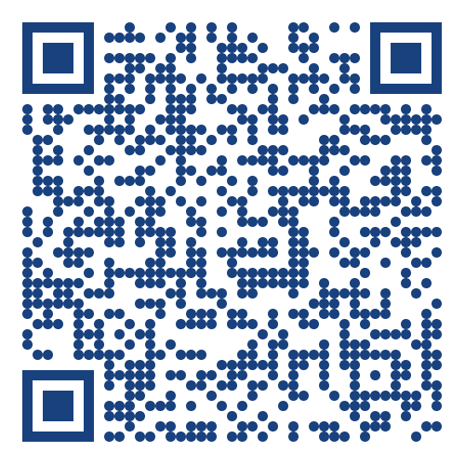
Health Center Staff: Give your input TODAY!
ALL health center staff are encouraged to complete the National T/TA needs assessment. It’s available in English and Spanish!
Who
Complete the 2024 National Health Center Training and Technical Assistance (T/TA)
Needs Assessment.
Tell us what training and professional development support you and your health center teammates need to best serve your community.
Help our training partners create learning opportunities designed with health center teams in mind.
August 19 - November 1, 2024
When
Click on this link
Or scan the QR code:
How
So you can help inform the training and professional development available to health center staff.
This project is supported by the Health Resources and Services Administration (HRSA) of the U.S. Department of Health and Human Services (HHS) as part of an award totaling $6,625,000 with zero percentage financed with non-governmental sources. The contents are those of the author(s) and do not necessarily represent the official views of, nor an endorsement, by HRSA, HHS, or the U.S. Government. For more information, please visit HRSA.gov.
Why

Slide 8
NNCC NTTAP Team
Jillian Bird, MSN, RN
Director of Training and Technical Assistance
Matt Beierschmitt, MPP
Senior Program Manager
Fatima Smith, MPH
Project Manager
Regina Brecker, MPH
Project Coordinator
Junie Mertus
Program Intern
Notes:
Introduce Team

Slide 9
The National Nurse-Led Care Consortium (NNCC) is a nonprofit public health organization working to strengthen community health through quality, compassionate, and collaborative nurse-led care.
NNCC’s mission is to advance nurse-led healthcare through policy, consultation, and programs to reduce health disparities and meet people’s primary care and wellness needs.
We do this through:
training and technical assistance
public health programing
consultation
direct care
NNCC’s NTTAP is funded by HRSA’s Bureau of Primary Health Care to provide subject matter expertise through the development, delivery, coordination, and evaluation of FREE training and technical assistance offerings to health center grantees and look-alikes.
This program is supported by the Health Resources and Services Administration (HRSA) of the U.S. Department of Health and Human Services (HHS) as part of an award totaling $550,000 with 0 percent financed with non-governmental sources. The contents are those of the author(s) and do not necessarily represent the official views of, nor an endorsement by, HRSA, HHS, or the U.S. Government.
Notes:
This page highlights more about NNCC and the multitude of ways we work to advance nurse-led care

Slide 10
Agenda
10 min - Introduction and Welcome
Background of telehealth role in modern healthcare (NNCC)
20 min - Jennifer Calohan, RN, TQMP, SOLC, SSBBCs
20 min - Dr. Jess Calohan, Board-Certified Psychiatric Mental Health Nurse Practitioner
10 min - Questions & Wrap-Up
Notes:
Go through agenda

Slide 11
Name + Credentials
Location
Role
and….
ICE BREAKER QUESTION
Notes:
Ask participants to icebreaker info in chat

Slide 12
Telebehavioral Health Use in Treatment
Key Applications:
Screening and Diagnosis
Online Counseling
Medication-Assisted Treatment (MAT)
Continuity of Care
Integrated Behavioral Health Care (IBHC)
Benefits of Telehealth:
Access for rural populations
Reduce stigma
Increases privacy
Minimizes time off work
Notes:
Speaker Notes:
Overview of Telehealth:
Telehealth is a promising tool for addressing substance use disorders (SUDs) and behavioral health conditions, offering innovative treatment options.
Key Applications:
Screening and Diagnosis: Telehealth enables remote assessments, making it easier to screen and diagnose patients efficiently.
Online Counseling: Patients can receive counseling and support online, eliminating the need for travel to a provider's office.
Medication-Assisted Treatment (MAT): This approach combines behavioral counseling with prescription medications, facilitating comprehensive care.
Continuity of Care: Patients can continue treatment with their existing therapists or providers, ensuring consistent support throughout their recovery.
Integrated Behavioral Health Care (IBHC): Telehealth supports integrated care in primary and outpatient practices, promoting a holistic approach to health.
Benefits of Telehealth:
Especially beneficial for rural populations where access to specialized behavioral health providers is limited.
Reduces the stigma of seeking treatment and enhances patient privacy.
Minimizes disruptions to daily life, as patients can receive care without taking time off work.
Resources:
The Substance Abuse and Mental Health Services Administration (SAMHSA) offers valuable information on various telehealth modalities for behavioral health.

Slide 13
Evolution and Impact of Telebehavioral Health
Telebehavioral Health Evolution
Historical Context
COVID-19
Accelerated telehealth by 154% for mental health services (CDC)
FQHCs report a 60% increase in patients receiving telebehavioral health services
Effectiveness of Telehealth
Outcomes comparable to in-person therapy
Improved treatment adherence
Notes:
Speaker Notes:
Historical Context:
Telehealth has significantly evolved over the years. Initially, it focused on basic phone consultations, primarily for follow-up care or consultations for patients who couldn't visit a clinic.
Today, it encompasses a wide array of services, including video therapy sessions, mobile health applications for self-monitoring, and remote patient monitoring technologies.
This evolution has enabled more personalized and timely care, bridging the gap between patients and providers.
Impact of COVID-19:
The COVID-19 pandemic acted as a catalyst for telehealth adoption. With social distancing measures in place, many healthcare providers shifted to telehealth solutions, resulting in a 154% increase in mental health service usage (CDC).
Emergency regulations, such as relaxed licensing requirements and increased reimbursement for telehealth visits, facilitated this transition and broke down previous barriers to access, making it easier for patients to receive care.
Federally Qualified Health Centers (FQHCs) have reported a 60% increase in patients receiving behavioral health services via telehealth during the pandemic.
Effectiveness of Telehealth:
Research indicates that telehealth interventions are effective in reducing symptoms of anxiety, depression, and substance use, with many studies showing that outcomes from teletherapy are comparable to those from in-person therapy.
Additionally, remote services have improved treatment adherence, especially in SUD recovery programs, by providing continuous support and reducing barriers to follow-up care.

Slide 14
BH and MH Prevention Services
Adoption of Telehealth
Early Screening and Assessment
Access to Preventive Counseling
Ongoing support
Effective in lowering relapse rates (NIDA)
Follow-up and Monitoring
Reducing Barriers to Care
40% increase in telebehavioral health use in underserved communities
Notes:
Early Screening and Assessment:
Telehealth significantly enhances the ability to conduct early screenings and assessments for mental health and substance use disorders (SUD).
Through video consultations and online questionnaires, healthcare providers can quickly identify issues and initiate interventions.
This approach is crucial for early detection, which has been shown to prevent the progression of disorders, leading to better long-term outcomes.
Access to Preventive Counseling:
Teletherapy and online counseling services offer consistent support to individuals at risk of behavioral health crises or substance misuse.
These platforms provide a flexible environment for therapy, making it easier for patients to engage in preventive care.
According to the National Institute on Drug Abuse (NIDA), remote counseling has proven effective in lowering substance use relapse rates. This highlights the importance of maintaining continuous therapeutic relationships, even when conducted virtually.
Follow-up and Monitoring:
Telehealth tools, including mobile apps and online platforms, facilitate regular follow-ups, allowing providers to monitor patient progress remotely.
This continuous engagement helps ensure that any early signs of relapse or deterioration in mental health are addressed quickly.
Studies have indicated that consistent follow-ups through telehealth improve treatment adherence, leading to better health outcomes for patients.
Reducing Barriers to Care:
One of the most significant advantages of telehealth is its ability to remove barriers that often prevent individuals from accessing care, such as transportation issues, time constraints, and the stigma associated with seeking help.
Research has shown a 40% increase in the use of behavioral health services through telehealth, particularly in underserved communities. This statistic underscores how telehealth makes preventive care more accessible and helps bridge the gap in healthcare disparities.

Slide 15
Trends and Innovations in Telebehavioral Health
Integrated Care Models
Mobile Health Applications
Teletherapy and Virtual Support Groups
Data-Driven Insights
Preventive Screening Tools
Notes:
Introduction: Today, we’ll discuss new trends and innovations in preventive telehealth for behavioral health and substance use disorders (SUD). These advancements are transforming mental health care and improving access for patients.
Integrated Care Models: Integrated care combines mental health and primary care services, addressing both physical and behavioral health needs. This holistic approach enhances communication among providers and improves treatment outcomes.
Mobile Health Applications: Mobile apps offer on-demand access to therapy, self-monitoring tools, and community support, breaking down barriers to care and reducing stigma.
Teletherapy and Virtual Support Groups: Teletherapy and online support groups provide convenient access to mental health services, especially for those in remote areas, promoting community and ongoing engagement.
Data-Driven Insights: Analytics help evaluate treatment effectiveness by tracking patient engagement and outcomes, allowing for continuous improvement of care strategies.
Preventive Screening Tools: Online screening tools identify at-risk individuals early, enabling timely interventions and proactive management of behavioral health issues.

Slide 16
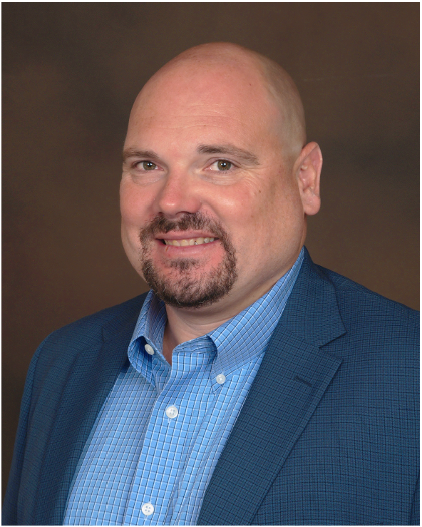
Subject Matter Experts
Jennifer Calohan, RN, TQNP, SOLC, LSSBB
Co Founder and Principal Consultant at CURIS
Jess Calohan, DNP, PMHNP-BC
Owner, Clinic Works Consulting, LLC.

Slide 17
Jennifer Calohan, RN, TQNP, SOLC, LSSBB
Co Founder and Principal Consultant at CURIS
Notes:
Jen is the co-founder, co-owner, and Principal Consultant of CURIS Consulting, with over 30 years of healthcare experience. A Registered Nurse by training, she has extensive expertise in clinical operations, leadership, and consulting, including roles such as Executive Administrator for a Rural Health Clinic. For the past 15 years, Jen has worked with various healthcare organizations to enhance clinical integration, develop patient-centered care models, and improve quality and population health management.

Slide 18
What Makes a High Performing Telebehavioral Health Program
Prepared by: Jennifer Calohan, RN, TQMP, SOLC, LSSBB
CURIS Consulting Cofounder/Principal Consultant

Slide 19
Is it Time for a “Reboot”?
We didn’t get time to adequately plan for the magnitude of change thrust upon us in March of 2020.
While we responded to the immediate needs of the pandemic, we were not able to optimally plan for long term change management, or prepare for the impact of the new tools, technology, and workflows on the day-to-day care delivery in our Health Centers – so…we are at a crossroads…is it time for a “reboot”?

Slide 20
Applying the 3 ‘P’s Principle
Now that the proverbial dust has settled…now is an ideal time to revisit our 3 ‘P’s – people, planinng, & process…to ensure a focus on:
*performance
*productivity
*quality
*safety

Slide 21
People – Leveraging Your Teams Efficiently & Effectively
Telehealth requires special attention on care team modeling
Roles and responsibilities must be clearly defined and clearly communicated
Workflow(s) need to be designed to be as efficient and effective as possible
Must be mindful of both clinical and non-clinical roles to protect peak of scope
Always include the perspective of the patient!

Slide 22
Planning – Regulatory Compliance
Be mindful of FTCA, credentialing, & privileging
Assess your program scope
Establish guidelines to define and determine your organization’s telehealth program criteria
Develop your organization’s telehealth policies
Establish decision making tools to determine what patients/types of visits do and do not meet criteria (hint…think patient safety & risk mitigation!)
Develop specific consent forms with necessary modifications

Slide 23
Process – Identify Processes Impacted Virtual Care Delivery
Check-In
Insurance Verification
Co-pay Collection
Intake Process/Virtual “Rooming”
Check Out/Discharge Instructions
Documentation (clinical & non-clinical data entry)
Refill Process/Medication Mgmt.
Communication (triage, patient follow-ups, addressing questions, managing message volume, outreach)and the list goes on……

Slide 24
Critical Process – Maintaining Access & Managing Resources
*Telebehavioral Health access is often limited due to resource constraints – so it is critical that our processes support access & resource management!
Define your inclusion criteria & referral process!
Providers and staff must have clear guidelines to determine appropriate patients for referral to specific BH services/specialties and the process to refer patients with highest time efficiency and fewest barriers.
Internal referrals vs. external/community referrals
Psychotherapy vs. Psychiatric Management
Appropriate resource utilization is key!
You must understand who makes up your Behavioral Health resource pool ~ not all resources are created equally!

Slide 25
Critical Process – Managing Supply & Demand
3. Define the process for patients to be returned for management
by PCP.
In order to manage supply and demand and allow continuous access for new patients to the Telebehavioral Health Program, it is essential to have a well defined (and mutually agreed upon) process for patients to return to primary care for management.
This is especially important in the case of limited Psychiatry resources who are providing specialty consultation, supporting complex psychiatric condition and/or medication management.
Once patients are determined to stable on established course of treatment, patients should (whenever safe & appropriate) be returned to PCP for ongoing management.
*These patients can continue to be seen by specialty provider as needed.
*This creates access and prevents new patient lag times and reduces risk related to delays in care.

Slide 26
Capturing Revenue – Optimizing Services & RCM Processes
The rapid changes in our reimbursement and revenue cycle management landscape requires that we put special focus and attention on optimizing revenue opportunities!
BUT HOW?
Know your payer mix (opportunities vary by payer)
Familiarize yourself with your existing contracts
Establish contact with a rep from your payers
Stay current with new codes and services available for billing!
Telebehavioral health coding errors result in lost revenue regularly!

Slide 27
Enhanced Outreach – Strategies for Success to Support Telehealth Program
Virtual Communication allows us to go “beyond the telephone” to reach out to our patients in a way that is more flexible, patient-centric, efficient and efficient
Allows for asynchronous communication
Allows patients to respond at their convenience
Much higher engagement than “cold calling” (+/- 40% vs. +/-10%)
Can reach more patients without bogging down staff
Can reduce incoming and outgoing call volume
Can capture important SDOH

Slide 28
Factors To Consider- Deciding on a Virtual Communication Tool
Does it come in multiple languages?
Is it bidirectional?
Can patients initiate the contact?
Can it be used for ‘on demand’ outreach?
Can it be used for batched/bundled outreach?
Is it easily customizable/configurable?
Does it generate important data/reporting?
Can it be used with and without integration to EHR?

Slide 29
Virtual Communication Use Cases… (the opportunities are endless here)
Appt Reminders
No Show Follow Up
New Med Checks
Post Appt F/U
SDOH – *promote self disclosure
Screening
Risk Identification & Stratification
ER Utilization Reduction
Triage
Transitions of Care
Referral Tracking & Follow Up/Loop Closure
Care Management/Care Coordination
Health Maintenance
Patient Engagement
Patient Experience
Patient Retention

Slide 30
Survival Mode is Exhausing!
Take pause to evaluate the changing “demands” in order to prepare the right adjustments to your “supply”.
Now is a great time to rely on strong change management skills to guide your organization through steps to:
improve current processes
develop new processes
assess your tools and technology
evaluate the gaps
create an action plan to move beyond “survival mode”!

Slide 31
Is Now the Right Time?
One of the biggest challenges facing health centers is our unintentional failure to set ourselves up for long term success.
We tend to…
Quickly implement new things - looking for a quick fix (because a short-term solution feels better than no solution)!
-or-
Resist the changes necessary to adapt or resist the adoption of new processes and tools that can support our long-term success.
So, we ask “is now the right time for
a reboot?”

Slide 32
Thank You!
Jennifer Calohan, RN, TQMP, SOLC, LSSBB
Cofounder/Principal Consultant
CURIS Consulting
Jennifer.Calohan@curis-consulting.com
360-470-8378

Slide 33
Jess Calohan, DNP, PMHNP-BC
Owner, Clinic Works Consulting, LLC.
Notes:
Jess Calohan, DNP, PMHNP-BC, is the owner of Clinic Works Consulting, LLC, a telepsychiatry company focused on improving psychiatric access to care in rural and underserved communities. A retired combat veteran with 20 years of service in the U.S. Army, he has shaped military mental health policy and treatment for PTSD, earning numerous awards including the Bronze Star. Dr. Calohan is also an accomplished educator, having held faculty positions at various universities, and was inducted as a Fellow into the American Academy of Nursing in 2021.

Slide 34
Telepsychiatry Services in Community Health Centers
Jess Calohan, DNP, PMHNP, BC
Lieutenant Colonel, United States Army, Retired

Slide 35
Objectives
Discuss telepsychiatry delivery model in Community Health Centers
Keys to success
Outcomes

Slide 36
Telepsychiatry Services
DIAGNOSTIC EVALUATION WITH TREATMENT RECOMMENDATIONS
DIAGNOSTIC EVALUATION AND MEDICATION MANAGEMENT
CURBSIDE CONSULTATION

Slide 37
How does the Telepsychiatry Work?
Home-based vs. clinic-based
Secure video platform (HIPAA compliant)
Consent and documentation
Policy
State regulations
Reimbursement

Slide 38
Keys to Success
Infrastructure
Primary Care Involvement
Support Staff Involvement

Slide 39
Outcomes
Increased access to psychiatric care
Increased patient satisfaction
Improved Primary Care Provider satisfaction
Reduction in emergent or acute behavioral health visits
Decreased no-show rates

Slide 40
https://telehealth.hhs.gov/providers?gad_source=1&gclid=Cj0KCQjwurS3BhCGARIsADdUH507zflvsF0siX-m-F504G4mYx-_vtD1KFj0w4CeqwLxAjLzGZSwlS0aAikXEALw_wcB
https://www.cchpca.org/telehealth-resource-centers/
https://telehealthtechnology.org/
Telehealth Resources

Slide 41
Questions?

Slide 42
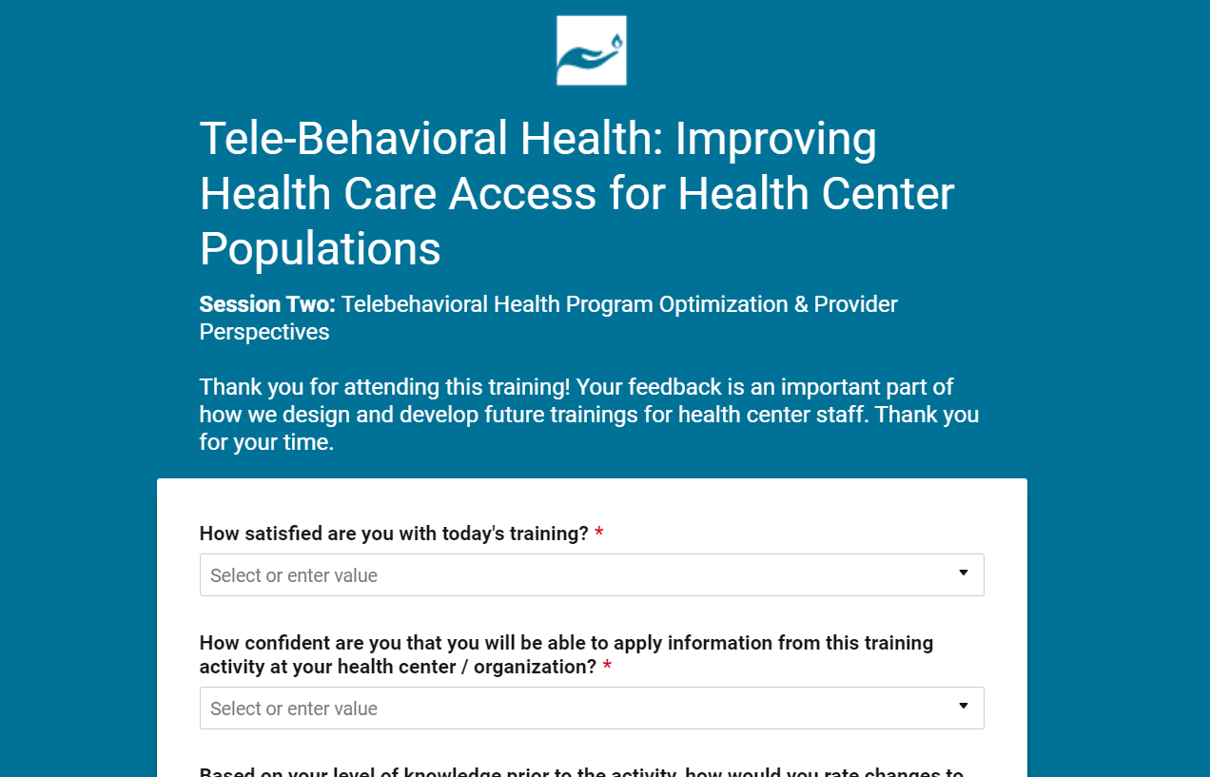
Evaluation Survey
Notes:
Show participants photo of Eval

Slide 43
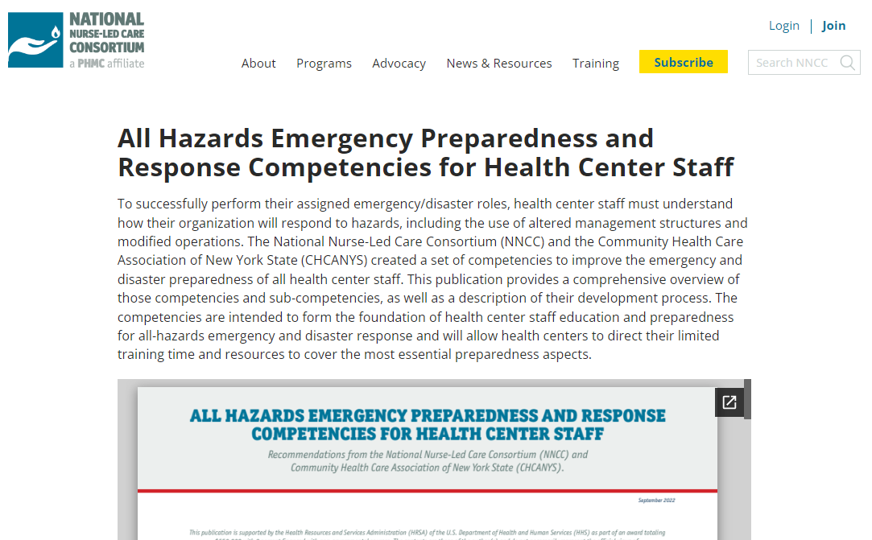
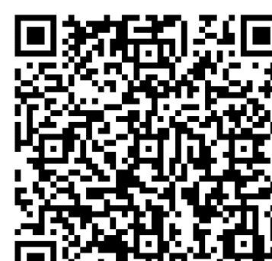
Access T/TA Resources
Google Site
NNCC Resource Library
Notes:
Links to our and other NTTAPS T/TA Resources

Slide 44
Upcoming Trainings
October 22nd, 2024- 3 PM EST
Empoderando a las Comunidades: Cómo las Promotoras de Salud Impulsan la Equidad en la Detección Temprana y Tratamiento del Cáncer de Mama
Registration: https://us02web.zoom.us/webinar/register/WN_2aVc7SZ2RP-6a1RguP3U4w
October 24th, 2024- 3 PM EST
The Role of Mental Health & Behavioral Health in Primary Care and Improving Telehealth at Your Health Center - Session 3
Registration: https://us02web.zoom.us/webinar/register/WN_fyDI1WqoQDmbMOkafnchlw
December 18th, 2024- 2 PM EST
Health Center Preparedness & Response Forum - Session 2
Registration: https://us02web.zoom.us/webinar/register/WN_RAWRSaX4R-uBZDtpm6rRXw

Slide 45
Thank You!
If you have any further questions
or concerns please reach out to
Fatima Smith fasmith@phmc.org
Subscribe for the Latest Updates
Subscribing to our email newsletter is the best way to learn about all of
NNCC's free webinars and other online learning opportunities.
SUBSCRIBE

