Slide 1



The Role of Community Health Workers in Breast Cancer Screening Equity
February 8, 2023, 2pm Est
This webinar is supported by the Health Resources and Services Administration (HRSA) of the U.S. Department of Health and Human Services (HHS) as part of an award totaling $550,000 with 0 percent financed with non-governmental sources. The contents are those of the author(s) and do not necessarily represent the official views of, nor an endorsement, by HRSA, HHS, or the U.S. Government. For more information, please visit HRSA.gov.

Slide 2
Welcome
The National Nurse-Led Care Consortium (NNCC) is a membership organization that supports nurse-led care and nurses at the front lines of care.
NNCC provides expertise to support comprehensive, community-based primary care.
Policy research and advocacy
Technical assistance and support
Direct, nurse-led healthcare services
Notes:
The National Nurse-led Care Consortium is a nonprofit housing programs that support nurse-led care in Philadelphia and across the nation. Throughout the organization we have ongoing efforts for policy research and advocacy, technical assistance support, and direct healthcare services.

Slide 3




National Center for Health in Public Housing (NCHPH)
The National Center for Health in Public Housing (NCHPH) is supported by the Health Resources and Services Administration (HRSA) of the U.S. Department of Health and Human Services (HHS) under grant number U30CS09734, a National Training and Technical Assistance Partner (NTTAP) for $2,006,400 and is 100% financed by this grant. This information or content and conclusions are those of the author and should not be construed as the official position or policy of, nor should any endorsements be inferred by HRSA, HHS or the U.S. Government.
The mission of the National Center for Health in Public Housing (NCHPH) is to strengthen the capacity of federally funded Public Housing Primary Care (PHPC) health centers and other health center grantees by providing training and a range of technical assistance.
Training and Technical Assistance
Research and Evaluation
Outreach and Collaboration
Increase access, quality of health care, and improve health outcomes
Notes:
The mission of the National Center for Health in Public Housing is to strengthen the capacity of Public Housing Primary Care grantees and other health center grantees by providing training and a range of technical assistance.
NCHPH is a project supported by the Health Resources and Services Administration and is National Training and Technical Assistance Partner and is 100% financed by this grant. The information presented today are those of the author.

Slide 4




Housekeeping
1
Captions
To adjust or remove captions, click the “Live Transcript” button at the bottom of your Zoom window and select “Hide Subtitle” or “Show Subtitle.”
Live Transcript
2
Questions
Please add your questions for the speaker and comments for the group into the Chat box.
Chat
3
Technical Issues
Please raise your hand to let us know or message us in the chat.
Raise Hand
4
Recording
6
This session will be recorded and available to view on Vimeo
Recording
Notes:
A few housekeeping notes as we get started. Live captions are enabled for this session. If you would like to disable this feature, click the Live Transcript button at the bottom of the Zoom window and select Hide Subtitle.
Participation from the audience is always encouraged. Please add any questions or comments you have for the speaker in the Chat function. Be sure to select all participants if you want your comments seen by everyone.
If you are having technical difficulties during the session, please raise your hand or message us in the chat—one of our team members will assist you accordingly.
And lastly, this session is being recorded. You will have access to all materials referenced during our session including a copy of the slides.

Slide 5
Continuing Education Credits
You may earn up to 1 CE for this activity offered by the Clinical Directors Network.
To receive CE credits, you must complete the post-session quiz.
This will appear once you close out of Zoom. You will be redirected to the CE link once you have finished the quiz.
Notes:
We are able to offer 1 credit hour of continuing education credits for the one hour session brought to you by the Clinical Directors Network. If you are seeking credits, you must complete the post-session evaluation. This will automatically appear when you close out of the session, and you will be re-directed to a short 5-question quiz upon completing the evaluation.
We are always looking to improve our own content and engagement. We highly encourage everyone to please take a minute to complete the evaluation survey at the end of the session anyway.

Slide 6
TODAY’S AGENDA
WELCOME & INTRO ( 5 MINS)
LITERATURE REVIEW ( 15 MINS)
DIDACTIC PRESENTATION & SHOWCASE (25 MINS)
Q&A (10 MINS)
WRAP UP (5 MINS)
Notes:
We are able to offer 1 credit hour of continuing education credits for the one hour session brought to you by the Clinical Directors Network. If you are seeking credits, you must complete the post-session evaluation. This will automatically appear when you close out of the session, and you will be re-directed to a short 5-question quiz upon completing the evaluation.
We are always looking to improve our own content and engagement. We highly encourage everyone to please take a minute to complete the evaluation survey at the end of the session anyway.

Slide 7

Literature Review
Notes:
We are able to offer 1 credit hour of continuing education credits for the one hour session brought to you by the Clinical Directors Network. If you are seeking credits, you must complete the post-session evaluation. This will automatically appear when you close out of the session, and you will be re-directed to a short 5-question quiz upon completing the evaluation.
We are always looking to improve our own content and engagement. We highly encourage everyone to please take a minute to complete the evaluation survey at the end of the session anyway.

Slide 8
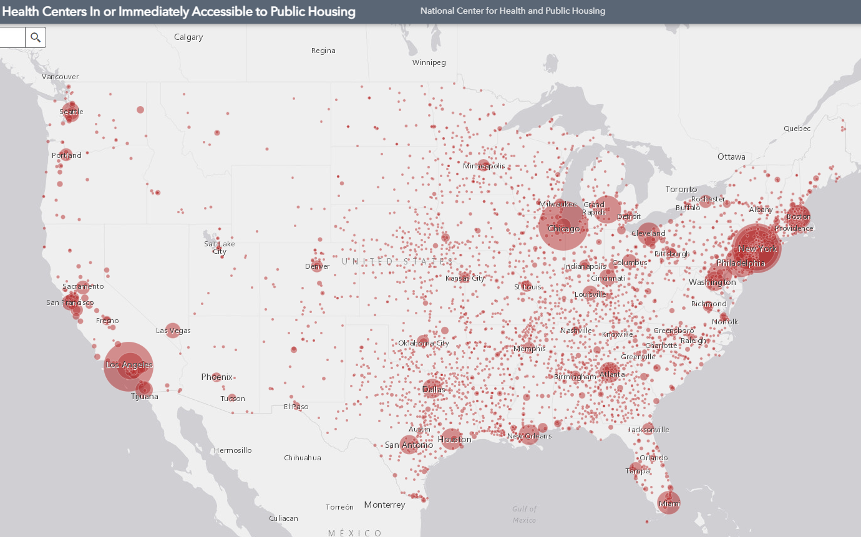
Health Centers Close to Public Housing
1,373 Federally Qualified Health Centers (FQHC) = 30 million patients
458 FQHCs In or Immediately Accessible to Public Housing = 5.7 million patients
108 Public Housing Primary Care (PHPC) = 911,683 patients
Source: 2021 Health Center Data
Source: Health Centers in or Immediately Accessible to Public Housing Map
Notes:
Fide to go over PHPC data for new attendees

Slide 9
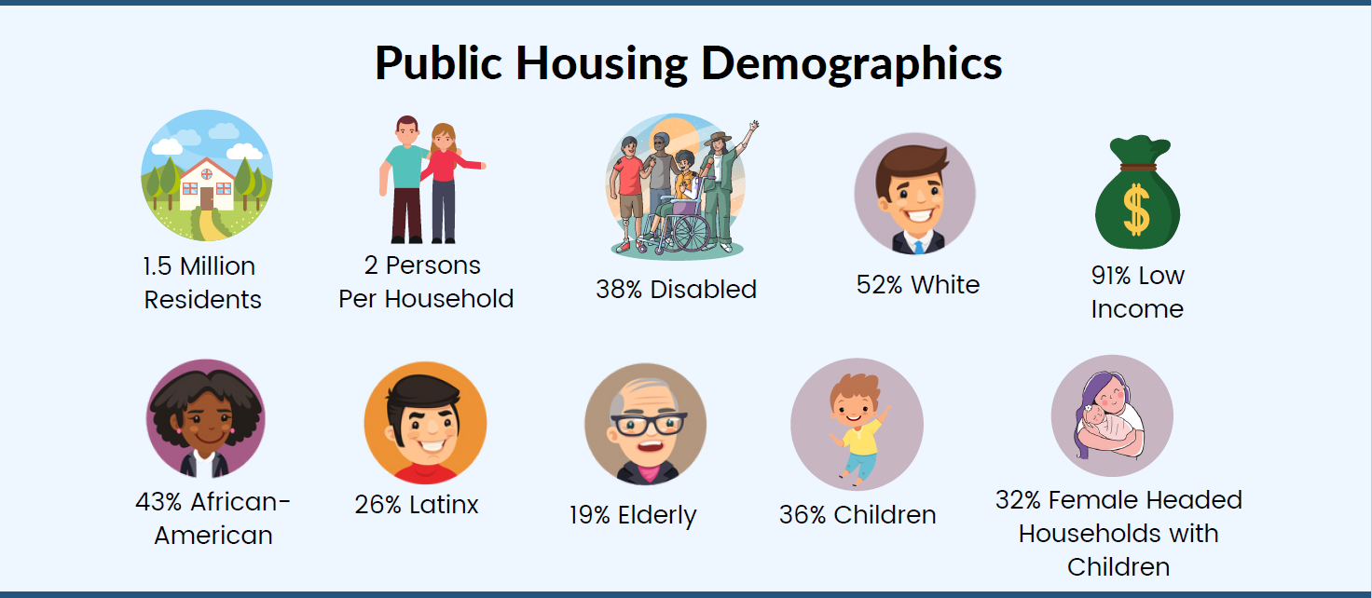
Notes:
Fide to go over PHPC data for new attendees

Slide 10


Learning objectives
By the end of this webinar, participants will be able to:
Identify ways community health workers can aid in breast cancer diagnosis and early interventions.
Report on the need for innovative care teams in cancer screenings, such as community health workers.
Implement community health workers in Breast Cancer Screening in their health center.

Slide 11
Section 1: How CHW's Can Aid in Breast Cancer Diagnosis/Intervention

Slide 12
Lessons from the Literature: The Role of CHWs in Addressing BC Outcome Disparities
Model 1:
Stepwise Impact
Model 2:
Synergistic Impact
Claim: Appropriate use of CHWs in supporting Breast Cancer screening, diagnosis and treatment impacts the social disparity process in a manner that leads to improved outcomes.
Claim: Appropriate use of CHWs in supporting continued medical treatment and education of Breast Cancer treatment has a synergistic affect, further impacting the likelihood of improved outcomes.
Notes:
The subsequent slides and studies will support the following models based on lessons learned from the literature and clinical practice.

Slide 13
Background
Disparities
Intervention
Role of CHWs
Disparities in breast cancer diagnosis and intervention in the US are well documented.
An individual's race/ethnicity, income and education have all been identified as independent barriers to diagnosis service access.
Individuals in less affluent counties have an approximately 10% lower rate of cancer survival. Much of this disparity is due to later diagnosis.
Considering the primacy of SDOH in serving as a barrier in diagnosis service access, interventions which impact these disparities directly can have a disproportionate impact on early intervention and survival.
CHW's are nonclinical, frontline public health workers who are often trusted members of their communities.
Improved outcome measures
Notes:
Before:
What are the key aspects of this story and how do they guide you

Slide 14





Lessons from the Literature: The Role of CHWs in Addressing BC Outcome Disparities
Analysis:
CHWs should be conceptualized as key members of interdisciplinary intervention to reduce outcome disparities.
When properly applied, CHWs and medical professionals act in a both a stepwise fashion and in a feedback loop to reduce disparities.
The preceding model with conceptualize this visually.
Notes:
Before:
What are the key aspects of this story and how do they guide you

Slide 15
Lessons from the Literature: The Role of CHWs in Addressing BC Outcome Disparities
Material Factors
Structural Determinant Factors
Socio-economic and political factors
Socio-economic
Position
Intermediary Determinants
Diagnosis/Treatment disparity
Social and Historical factors
Analysis:
Structural and socioeconomic factors work in a stepwise fashion to alienate certain individuals from recommended diagnosis/treatment services.
On a population level for breast cancer, this increases the likelihood of outcome disparities, such as higher-stage condition on diagnosis and lower five-year survival rates.
Outcome Disparity
Notes:
Before:
What are the key aspects of this story and how do they guide you

Slide 16
Lessons from the Literature: The Role of CHWs in Addressing BC Outcome Disparities
Material Factors
Structural Determinant Factors
Socio-economic and political factors
Socio-economic
Position
Intermediary Determinants
Diagnosis/Treatment disparity
Social and Historical factors
Analysis:
CHW's can be utilized to intervene in the later stages of the outcome disparity process, through interventions that increase/encourage access to diagnosis/treatment services and assuage historically or socially-grounded behaviors that act as barriers to appropriate carte.
CHW's can also support the treatment/diagnosis process, by serving as social interpreters/translators and supporting appointment/medication adherence.
The impact of these two aspects of disparity intervention is synergistic.
Outcome Disparity

Slide 17
Section 2: The need for CHWs in Breast Cancer diagnosis/Treatment

Slide 18
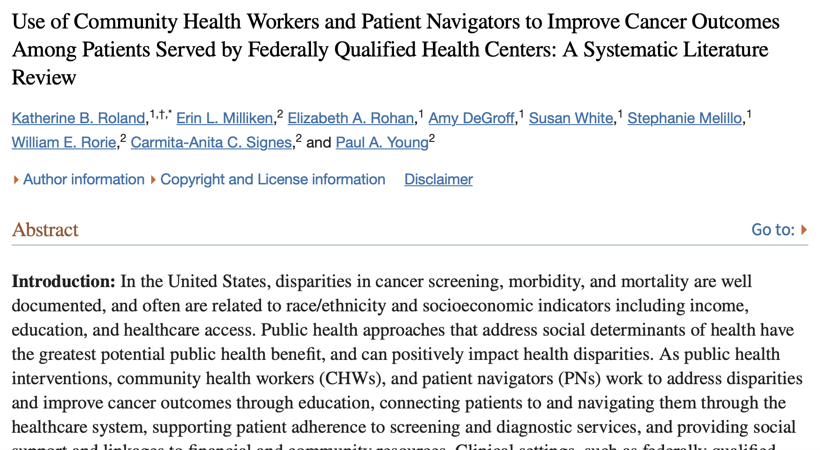
CWS/ Breast Cancer Interventions
Analysis:
24 articles identified investigating the role of CHWs in reducing cancer outcome in FQHS's.
Analysis completed utilizing an adapted meta-analysis methodology.
Primary outcome measures: cancer screening, time to diagnosis and completion.
22/24 studies indicated positive outcomes resulting from CHW intervention.
Women with an abnormal breast or cervical screening result had a significantly shorter time to diagnosis.
Notes:
Article:
https://www.ncbi.nlm.nih.gov/pmc/articles/PMC5586005/

Slide 19
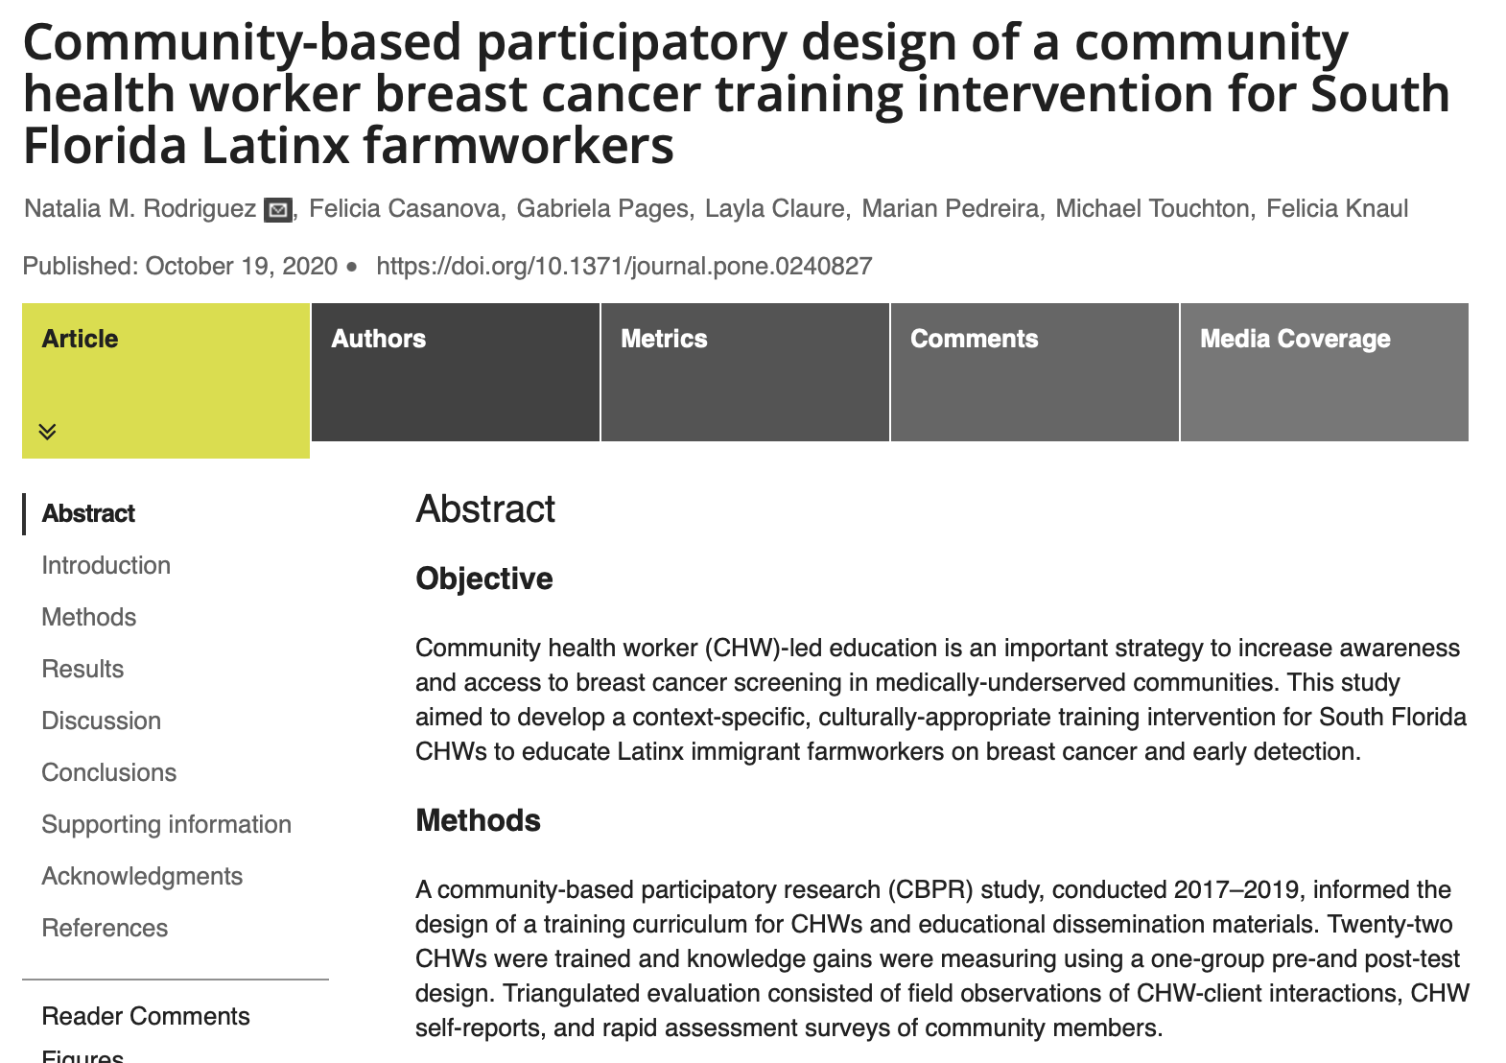
Program design, implementation and Evaluation
Analysis:
22 CHW's trained for use in BC screening and intervention.
Training was based on a two-year interdisciplinary co-learning process.
Evaluation based on qualitative analysis of participant interviews/focus groups, expert interviews and participant observation.
Results indicated gains in psychosocial support of breast cancer patients.
Education efforts must be accompanied by access to reputable sites for screening and diagnosis.
This study supports the stepwise and synergistic models of CHW application
Notes:
Article:
https://journals.plos.org/plosone/article?id=10.1371/journal.pone.0240827

Slide 20
Section 3: Best Practices and Proposed Actions

Slide 21
Designing CHW Interventions: The Abbreviated Process
Scientific Program Design and Evaluation
Funding and Stakeholder Engagement
Claim: Appropriate use of scientific design and evaluation principles allows responsible design of CHW intervention efforts in a manner that is maximally transparent and facilitates both interdisciplinary exchange and institutional control.
Claim: The use of scientific design and evaluation principles provides the data, analysis and processes which can more easily facilitate and maximize external funding yield. These also provide a platform for stakeholder engagement and feedback collection/analysis.
Notes:
The subsequent slides and studies will support the following models based on lessons learned from the literature and clinical practice.

Slide 22
Designing CHW Interventions: The Abbreviated Process
Step 1: Survey/Surveillance
Analysis:
Is there a Breast Cancer Disparity in your population?
The following investigations may be performed:
Medical record review.
Community interviews and focus-groups.
Query of local physicians and/or public health experts.
Interview of local community members.
A query of external funding sources or potential collaborators should be performed.
Results should be analyzed, and data/analyses made available to stakeholders as appropriate
Based on the unique needs of your community research should be completed to analyze the presence of Breast Cancer disparities in your community.
The impact of interventions cannot be maximized without an appropriate understanding of the presence of the disparity and the opinion of community members/stakeholders.
Applicability of local IRB approval should be prioritized.

Slide 23
Designing CHW Interventions: The Abbreviated Process
Step 2: Design Intervention
Analysis:
Based on the results of your initial survey and analysis, program design efforts can now be initiated:
A literature review should be performed to investigate similar interventions that have been by similar health centers.
A single individual should be assigned as responsible for program design.
Interdisciplinary input by different levels of staff and community members should be encouraged.
The availability of external funding sources should be considered when designing an intervention.
Final approval should include local and institutional stakeholders
The availability of external funding sources and potential collaborators and their respective needs should be performed.
Community focus groups are an appropriate method of engaging local community members.

Slide 24
Designing CHW Interventions: The Abbreviated Process
Step 3: Pilot and Analysis
Based on your program design, a pilot program may be appropriate. This facilitates the following benefits.
Low initial cost of intervention.
Preceding data collection/analysis can facilitate application for external funding and collaborator recruitment.
Providing initial data to stakeholders can increase trust within the receiving community.
Preceding results are utilized in program review, amendment and final implementation.

Slide 25
Designing CHW Interventions: The Abbreviated Process
Step 4: Program Surveillance
After implementation program surveillance efforts should be performed on regular intervals. The following questions should be addressed:
How has the program impacted Breast Cancer outcome measures (screening, diagnosis, treatment, outcome)?
How has the program impacted community awareness of Breast Cancer screening, treatment and prevention?
How have CHW skills been facilitated, improved and maintained?
How has the program facilitated external funding and collaboration?
Program surveillance efforts may be instrumental in securing additional funding and collaboration, as well as maintaining trust and awareness within the receiving community.

Slide 26
Final Thoughts on CHWs:
Investment in Your Community
Maintaining and improving staff quality measures
Claim: CHWs should be recruited from your community. They represent investments in your community's human capital.
CHWs also can serve as vessels for better interdisciplinary staff collaboration
Claim: Funding for CHWs can often be difficult and complicated. Although their efforts are typically non-reimbursable FQHS's which use CHWs report higher levels of job satisfaction and lower burnout among clinical and administrative staff members.

Slide 27
Contact us
Robert Burns Program Director Bobburns@namgt.com | Jose Leon, M.D. Manager of Clinical Quality jose.leon@namgt.com
Kevin Lombardi, M.D., M.P.H. Manager of Policy, Research, and Health Promotion Kevin.lombardi@namgt.com | Fide Pineda Sandoval, C.H.E.S. Training & Technical Assistance Manager Fide@namgt.com
Chantel Moore, M.A.​ Manager of Communications​ Cmoore@namgt.com | Please contact our team for Training and Technical Support 703-812-8822

Slide 28
Thank you!

Slide 29

Didactic & Showcase

Slide 30
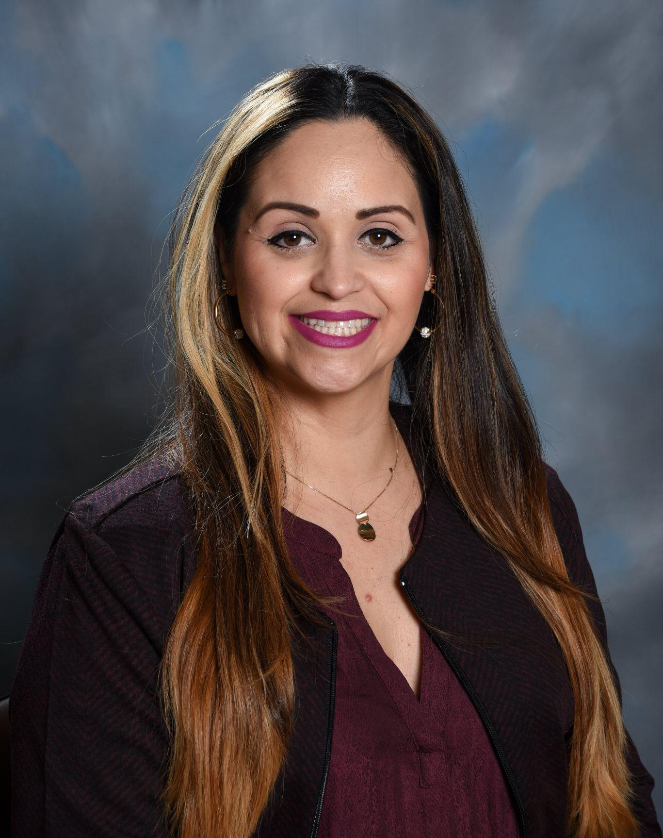
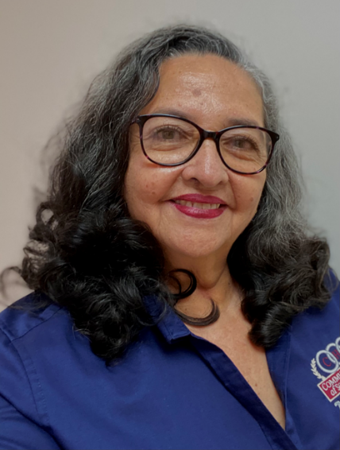
Subject Matter Experts
Eunice N. Hines, MPH, CCHW, CHC
Rocio Vivas, CCHW
Notes:
Eunice Hines
Miss Hines is the Director of Migrant Health Services and Outreach of the Community Health of South Florida. During her fifteen-year tenure at CHI, she has concentrated her efforts on serving at-risk populations in South Florida. She has led and coordinated various evidence-based programs for patients in education in chronic disease, self-management workshops, and the effective recovery of at-risk patients. Ms. Hines currently holds a seat as aboard member for the National Healthcare fo the Homeless Council, serves as an active member of the Mobile Healthcare Association (MHA), functions as a co-chair of the Florida Regional Colation for the MHA, and participates in partners service agencies provider meeting with local organizations. Ms. Hines’s career has been a result of her passion to gain an understanding of what the community needs are and to help create an impact within the various populations, all to provide better health outcomes.
Rocio Vivas
For the past 25 years Rocio Vivas has dedicated her efforts to the community of Homestead and Florida City. Inspired by her own story and motivated to help others in need, she started working at Community Health of South Florida in 1997. She addresses community medical needs to the farm workers, migrant families, and so much more. Working in different programs such as Jessie Trice Cancer Prevention Program, Healthy Body Healthy Soul, PAMPER Program and others, she has dedicated countless hours and hard work to improved herself and the community around her as a Health Promoter.
In April 2015, she became a Certified Community Health Worker and has since participated in education campaigns, prevention programs, and completed many benefit enrollments with DCF and the Affordable care act. Some roles she has taken on since then include:
Education campaign about AIDS and HIV virus
Prevention and education program for breast cancer (triple touch)
Health education on cervical cancer
Program enrollment lung cancer and smoking cessation education
Counseling for elderly people (Medicare)
Recovery Program patients with chronic diseases (diabetes, Pap smear, childhood vaccination
Applications for health insurance (Medicaid, ACA)
Among the certifications and trainings in which she has participated in include:
Triple Touch Breast Health Instructor Certificate
Evaluation of Pesticide Exposure of Farm Workers Certificate
Volunteer Counselor Certificate Shine
Sterling Six Sigma Green Belt Certification
Empowerment and Civic Engagement Training NHCOA
Medication Therapy Management University of Florida
Certified Application Counselor
The Community Interpreter Healthcare/Medical Edition

Slide 31
Jessie Trice Cancer Prevention Program
Rocio Vivas, CCHW
Eunice N. Hines, MPH, CCHW, CHC
Director for Migrant Health & Outreach Services

Slide 32
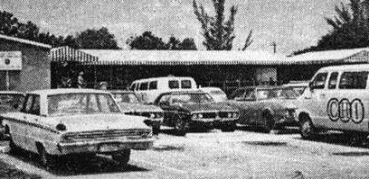
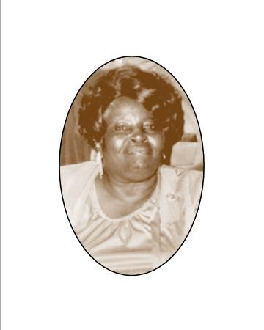
HISTORICAL OVERVIEW
From a humble beginning in two trailers in 1971 near US Hwy 1 and 216th street, CHI began with a commitment to community-oriented primary care for all residents of South Miami Dade. That same commitment is evident today.
Notes:
Lets talk about CHI. This is important to know because then you will realize passion behind everything we do. The lady that you see there is Doris Ison - Bahamian descent, advocate for the underserved in South Dade in the early 70s. Founder of CHI. The story was that there was no healthcare facilities in the area and babies were dying on their way to the hospital 30 minutes away.
It took someone with very little education, a migrant to put a seed of love, of caring, and be so passionate about making this point that we became who we are today, we cant forget where we come from.

Slide 33
Mission
To deliver safe, accessible, compassionate and culturally competent quality health care services to the people of South Florida while training the next generation of health care professionals.
Vision
To become the health care provider of choice for the people in South Florida and a teaching center of excellence for health care professionals.
Notes:
Our mission and vision focuses on delivering healthcare while training the next generation of health care professionals to do the same.

Slide 34
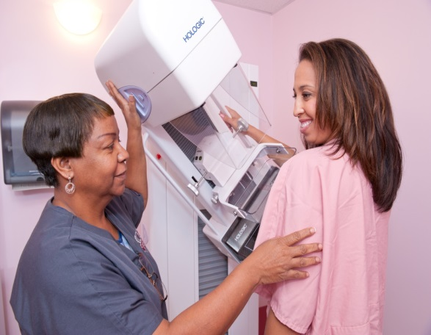

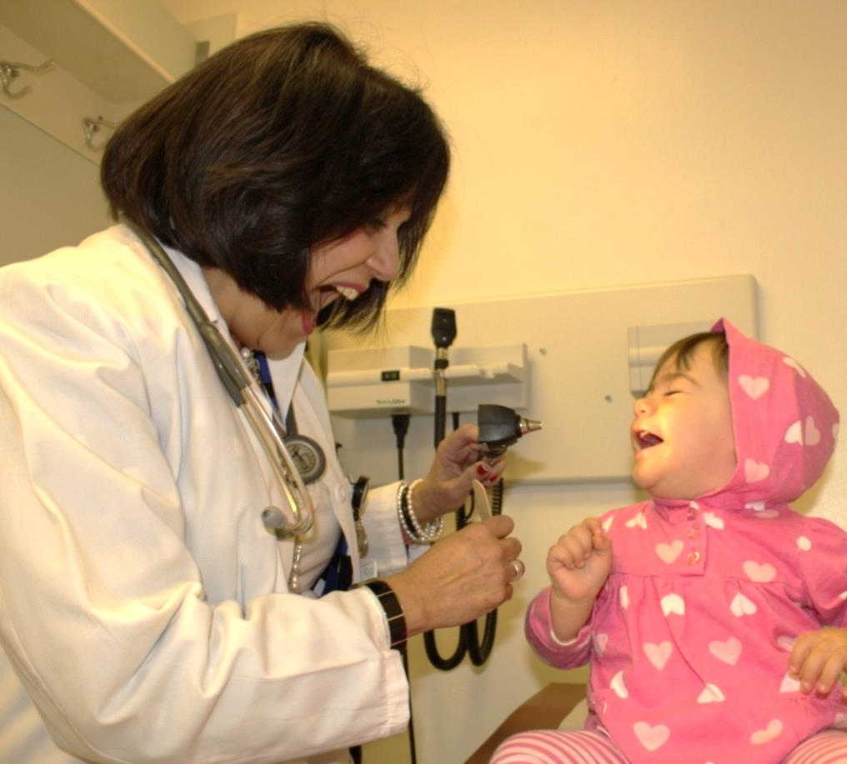
“Patient Care Comes First”
Notes:
Patient Care Comes First our everyday motto.
Everything that we do needs to revolve around the why…why? Because their care comes first.
Why are we training? Because their care comes first.
Why do we outreach? Because their care comes first.
Why do we promote this health event? Because their care comes first.

Slide 35
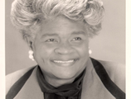
Program Background
Jessie C. Trice, a trailblazer in the Community Health Center Movement. Former Chairperson of National Association of Community Health Center Board of Directors.
The Jessie Trice Prevention Program is an innovative community-based initiative to educate and screen women for breast and cervical cancers.
South Florida residents lack access to healthcare, low beat cancers screening rates, limited medical knowledge, and greater exposure to risk factors for breast cancer.
In collaboration with partner federally qualified health centers, the JTCPP was created to reduce the rate of death from cancer among the low income African American and Hispanic populations.

Slide 36
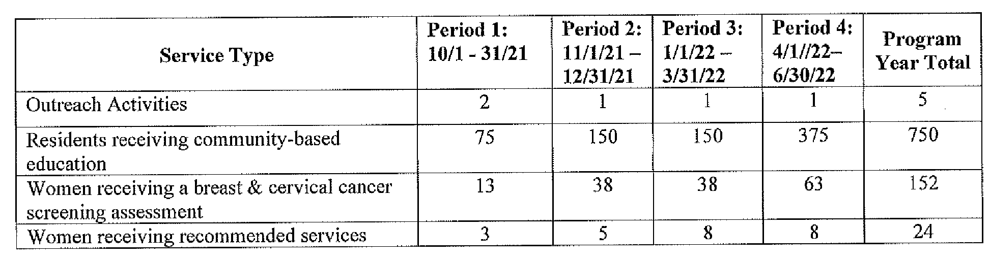
Project Goals 2021-2022

Slide 37
Program Design
JTCPP aimed to ensure every woman received a breast and cervical cancer through education.
Breast and Cervical models:
  Show how to do a self breast exam
  Aprons
  Literature
Assessment and screening also facilitate to link to healthcare services
Demographics
Family History
Breast Cancer Assessment
Cervical Cancer Assessment
Recommendations / Referrals
Outreach Database
Access by FQHCs to analyze variables related to number of participant screened, screenings outcomes, referrals and linkage, follow up as well as demographics

Slide 38
Program Implementation
People
Methods
Verbal, touch, and feel of the breast models, pictures, language, and charisma.
Implemented utilizing Certified Community Health Workers that would go into the community to educate and assess woman of all ages on the importance of prevention on breast and cervical cancers
Education session were held at school events, parent /teacher events, health fairs, church events, over the phone education session, zoom meetings and in reach opportunities.

Slide 39
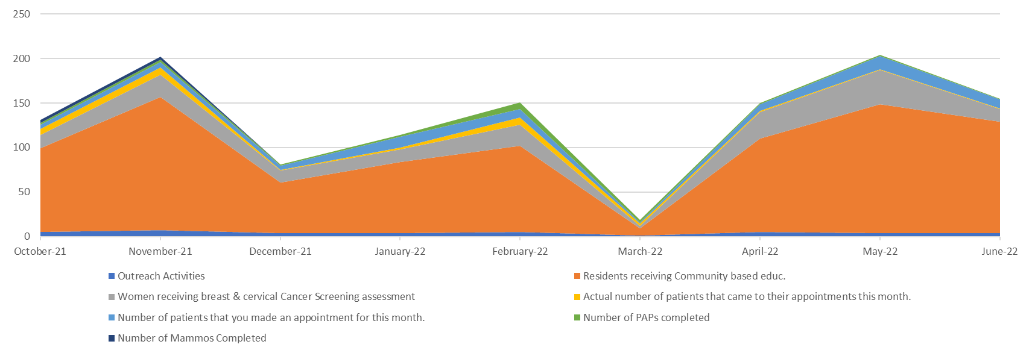
Outcomes
Jessie Trice Cancer Prevention Program 2021-2022
Notes:
Education 861
Assessments 176
Appointments made 71
Paps completed 22
Outreach events 39
Mammos completed 6

Slide 40
Race, Ethnicity, and Age
Race & Ethnicity | CHI |  | Total
 | Count | % | Count | %
Asian or Pacific Islander | 1 | 0.3 | 1 | 0.3
Black, Hispanic | 3 | 0.8 | 3 | 0.8
Black, Non Hispanic | 33 | 8.7 | 33 | 8.7
Unknown, Other | 3 | 0.8 | 3 | 0.8
White, Hispanic | 336 | 88.4 | 336 | 88.4
White, Non Hispanic | 4 | 1.1 | 4 | 1.1
Totals: | 380 | 100.0 | 380 | 100.0
 | Age | CHI |  | Total
 |  | Count | % | Count | %
 | 18 - | 3 | 0.8 | 3 | 0.8
 | 18 - 25 | 22 | 5.8 | 22 | 5.8
 | 26 - 35 | 67 | 17.6 | 67 | 17.6
 | 36 - 55 | 189 | 49.7 | 189 | 49.7
 | 55 + | 99 | 26.1 | 99 | 26.1
 | Totals: | 380 | 100.0 | 380 | 100.0

Slide 41
Pearls
Challenges
Lessons
Funding for staff to provide productivity of program, program funding is not a full year, & continuum of care.
Uniform Data System for Federally Qualified Health Centers; new patients that fail to complete the health screenings becomes CHIs responsibility
Eligibility for the program services, cost is an issue in term of getting the participants to follow through with services.
Importance of creating partnerships with initiative that can have potential audience.
Creating a relationship with patient. Creating a relationship with provider and staff for referral point.
Continued education for Outreach to keep up with screening requirements for PAPs and Mammograms.
Being innovative in capturing audience outside of the health center, in zooms, and in-reach.

Slide 42
Program Sustainability
Grant
  Subcontractor with Health Choice Network
  Providing JTCPP since 2010
The program is divided into 4 invoicing/payment periods, with its education, assessment, appointment and events, each with separate deliverables.
Monthly meeting with proof of appointments and results are required
Penalization if deliverables are not met per period in accordance with the contract remedies established by the state of Florida, DOH.
  Penalization per deliverable per person
Annual Audits facilitated by the DOH
  Electronic/ email/ protected

Slide 43
THANK YOU!
Rocio Vivas, CCHW
contact:
305-992-5908
rvivas@chisouthfl.org

Slide 44
Q&A
Notes:
We are able to offer 1 credit hour of continuing education credits for the one hour session brought to you by the Clinical Directors Network. If you are seeking credits, you must complete the post-session evaluation. This will automatically appear when you close out of the session, and you will be re-directed to a short 5-question quiz upon completing the evaluation.
We are always looking to improve our own content and engagement. We highly encourage everyone to please take a minute to complete the evaluation survey at the end of the session anyway.

Slide 45


Slide 46

Access our resources in the Clearinghouse

Slide 47
Wrap Up & Evaluation
Please help us measure our impact with this webinar by filling out the evaluation survey that will pop up on your screen as you exit Zoom.
You must complete the survey to be redirected to the CE link.
Thank You!
Notes:
We will send out a recap email with today’s resources and materials

